Slide 1

We must help
People around!

Slide 2


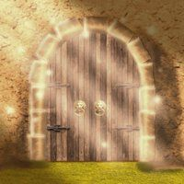

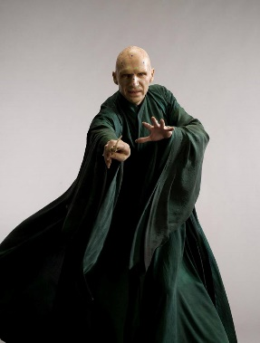

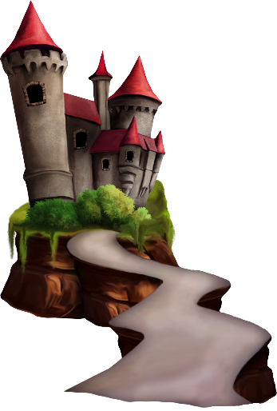




A
D
G
B
E
F
C

Slide 3

Our plan
Help
Harry Potter
say
magic words
go to
Hogwarts
find
a secret code
open
the magic door

Slide 4

A friend in need
is a friend indeed

Slide 5
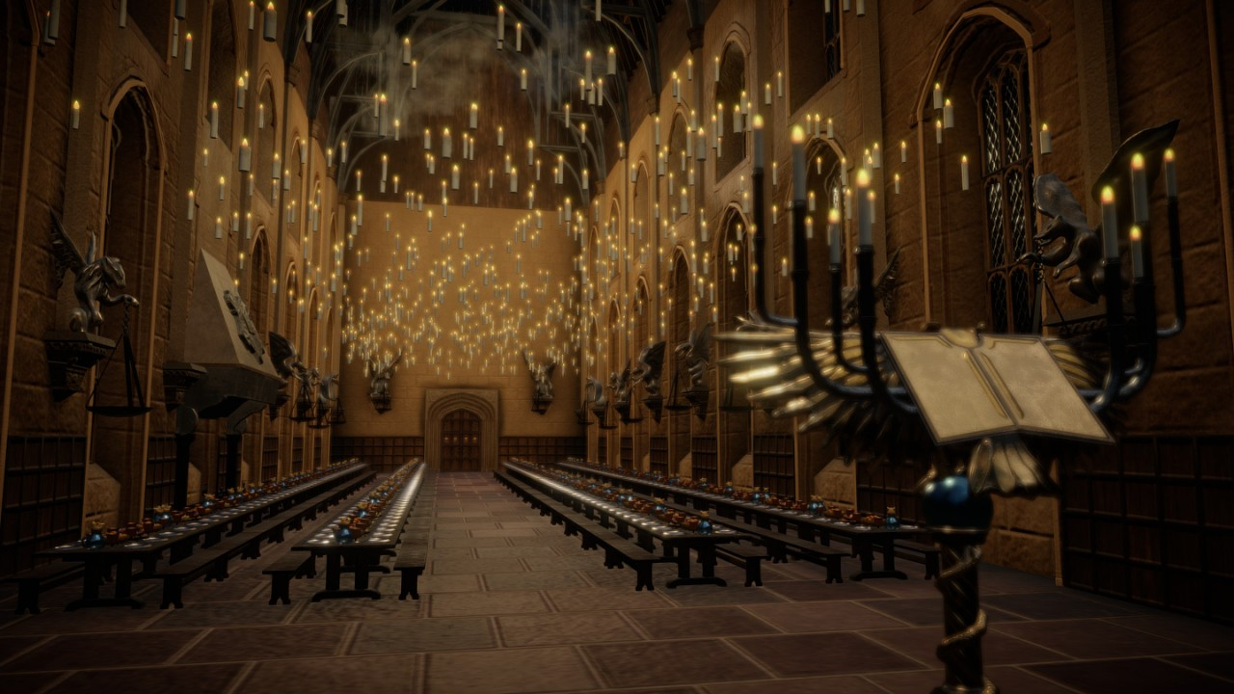
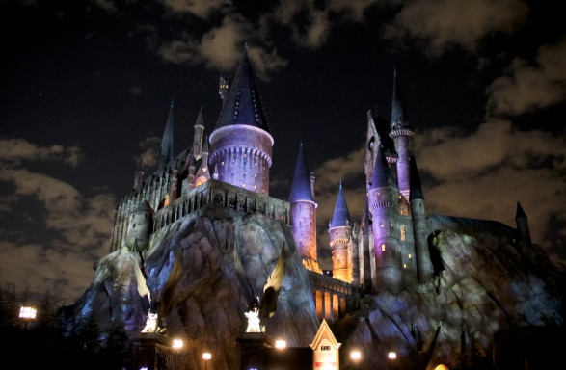
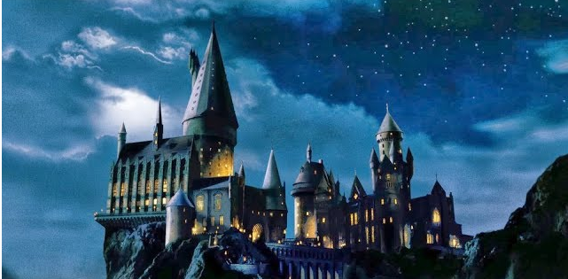
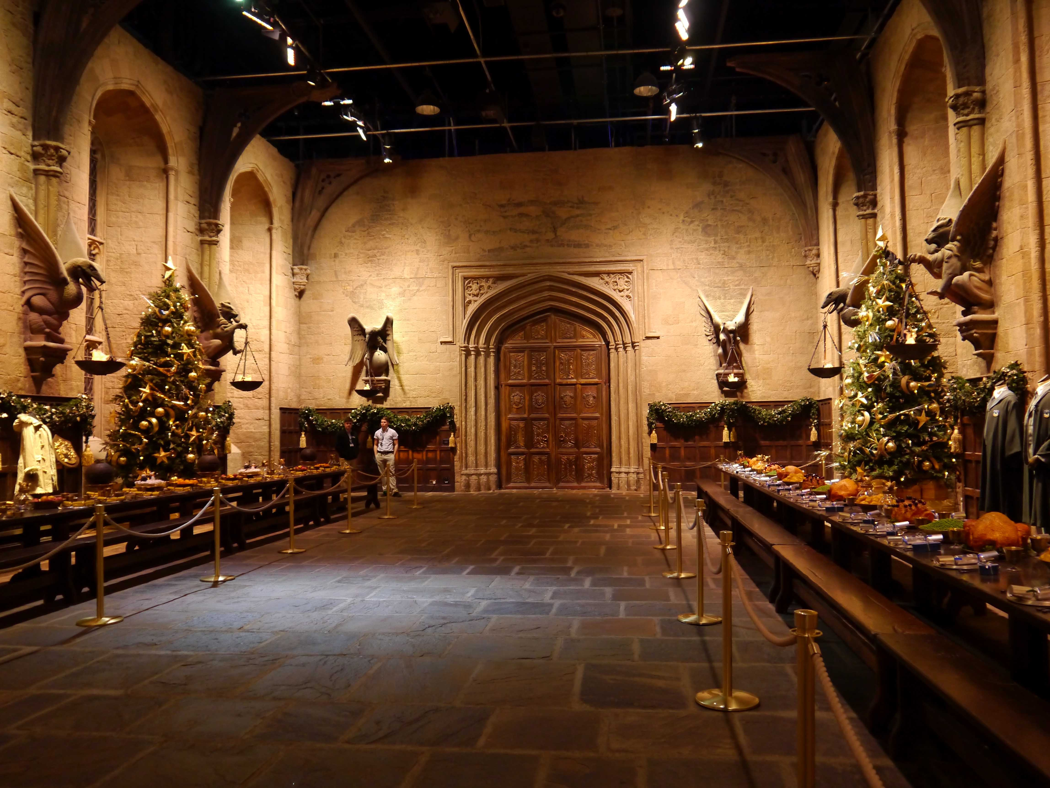



Slide 6

What faculty are you in?
GRYFFINDOR
SLYTHERIN

Slide 7
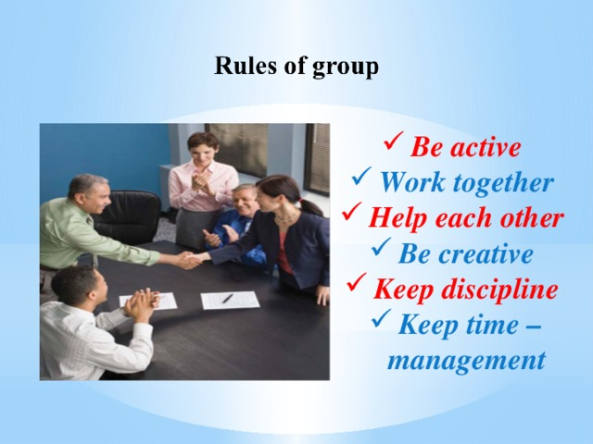

Slide 8
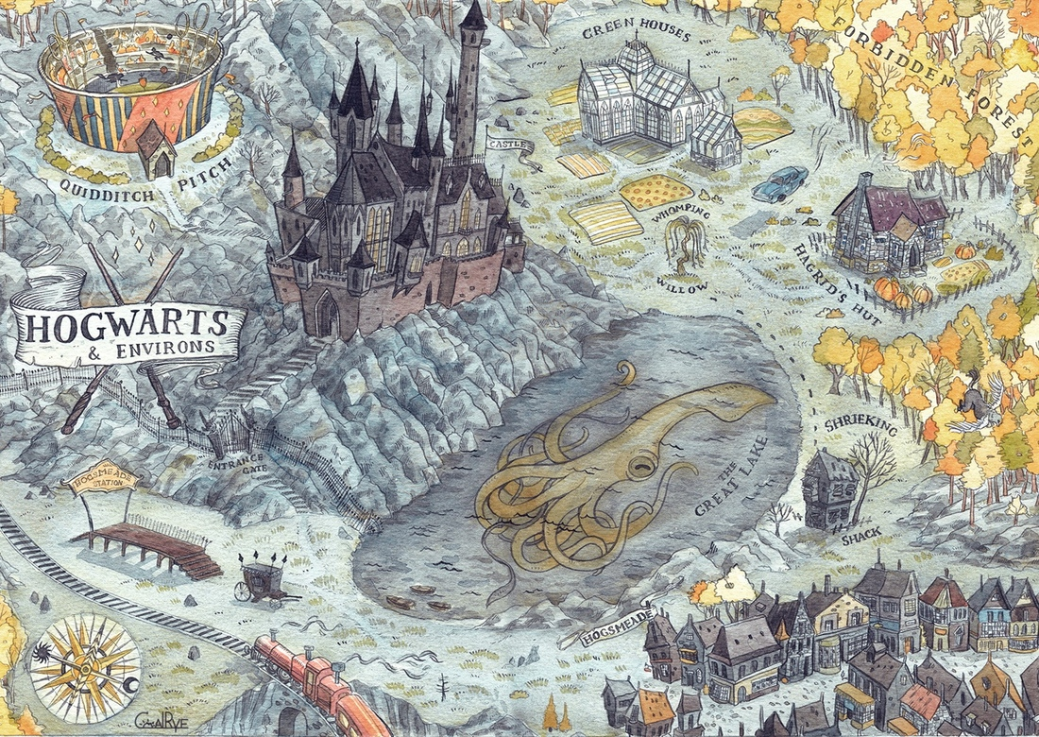
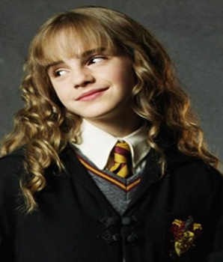
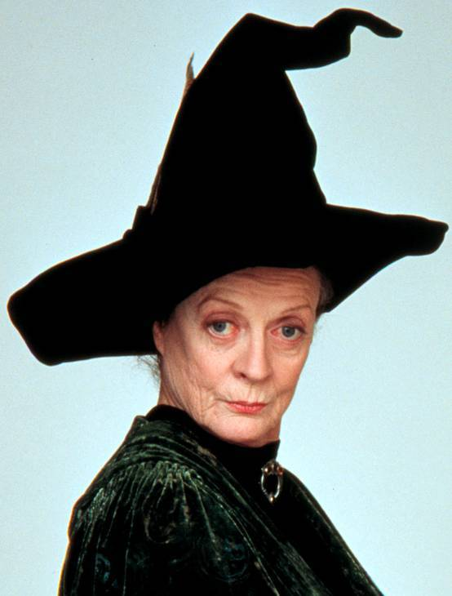
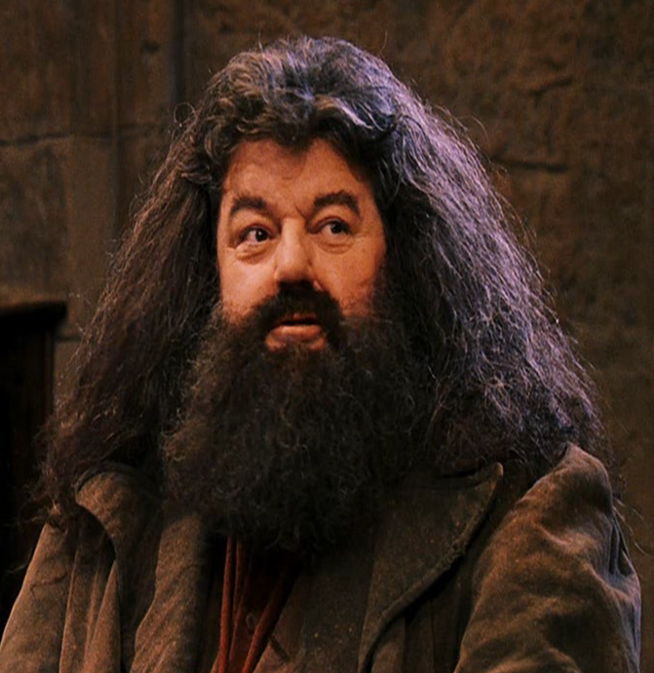

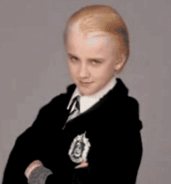
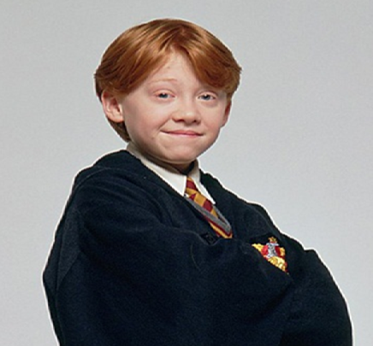
HARRY

Slide 9
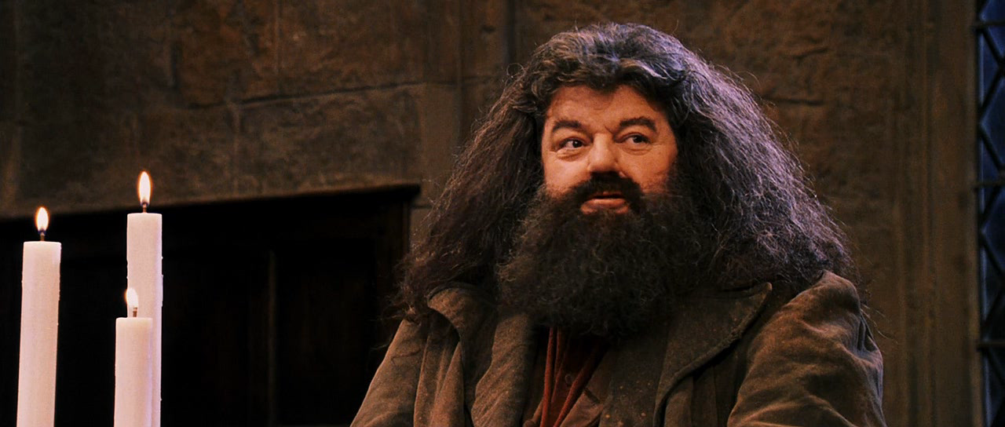
I will help you if you know magic characters and things!

Slide 10
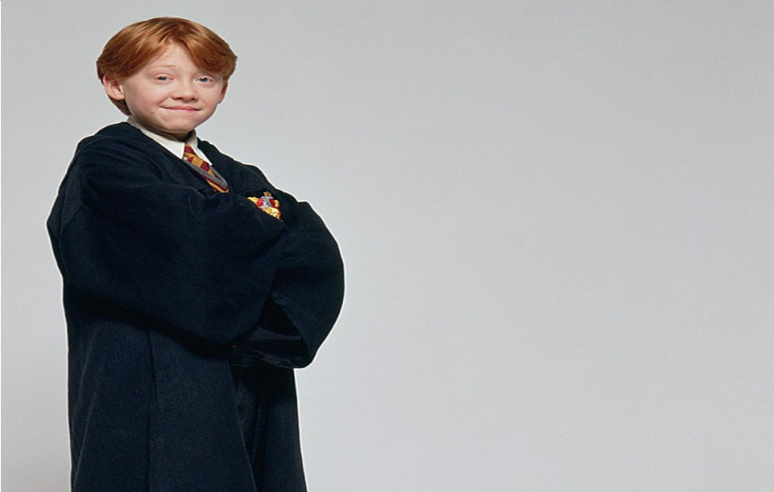
I will help you if you know poems about good deeds!

Slide 11
I will help you if you make sentences in Present Perfect!

Slide 12

I will help you if you
can play Quiddich!

Slide 13
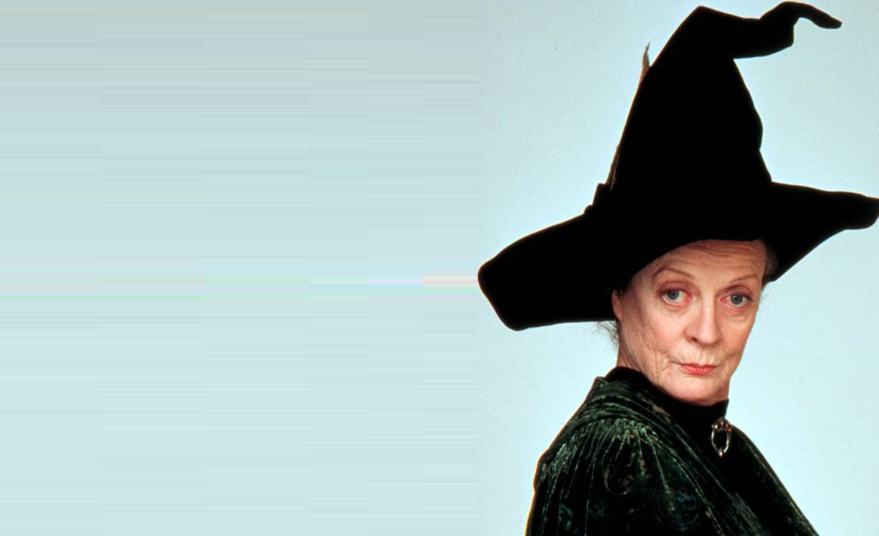
You can open the door
If you are good at maths!

Slide 14


Slide 15



22
28
45
4
98
9
68
14
45
57
F
R
I
E
N
D
S
H
I
P

Slide 16
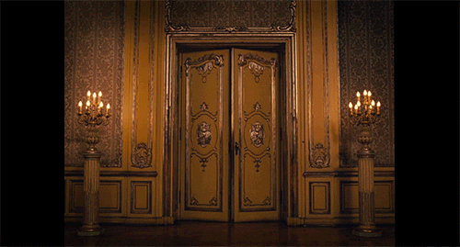

Slide 17


Our results
Help
Harry Potter
say
magic words
go to
Hogwarts
find
a secret code
open
the magic door

Slide 18


Slide 19
Present Perfect
1
2
3
have
V3 .
+
has
1
2
3
Hagrid has cleaned his house.

Slide 20
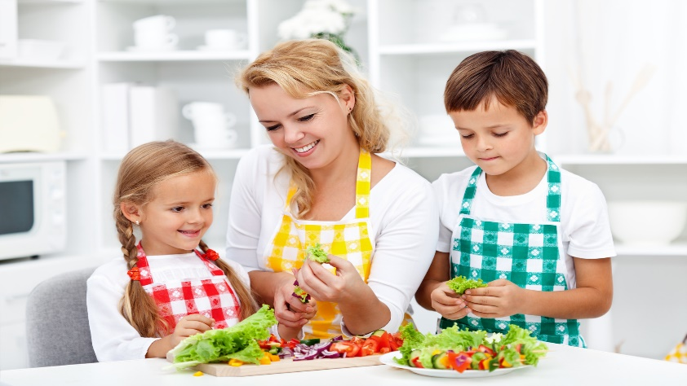
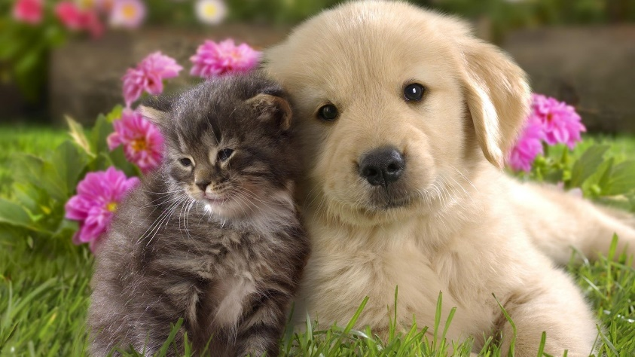
Make conclusions!
mother
I should help my_______.
I should take care of the_______.
animals

